Slide 1
Creating Binary Trees using Tikz
Keshav Malhotra

Slide 2
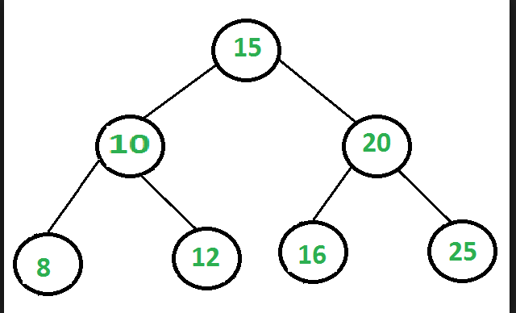
Trees are a common way of visualizing hierarchical structures.
In computer science, a binary tree is a tree data structure in which each node has at most two children, which are referred to as the left child and the right child.

Slide 3
Applications of binary trees
Binary Search Tree - Used in many search applications where data is constantly entering/leaving, such as the map and set objects in many languages' libraries.
Huffman Coding Tree - used in compression algorithms, such as those used by the .jpeg and .mp3 file-formats.
Heaps - Used in implementing efficient priority-queues, which in turn are used for scheduling processes in many operating systems, Quality-of-Service in routers, and A* (path-finding algorithm used in AI applications, including robotics and video games). Also used in heap-sort
T-tree - Though most databases use some form of B-tree to store data on the drive, databases which keep all (most) their data in memory often use T-trees to do so.

Slide 4
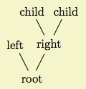
In Mathematics, the more natural way of drawing trees is showing the root at the bottom and growing the trees upwards from it which is shown below.

Slide 5
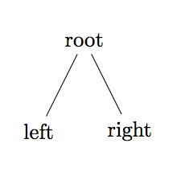
Simple binary tree in tikZ
\begin{tikzpicture}
\node {root} %creates root node
child {node {left}} %specifies left child
child {node {right} %specifies right child
};
\end{tikzpicture}

Slide 6
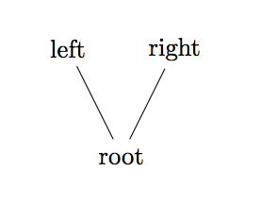
Tree that grows upward can simply be drawn using drawn by specifying “grow’-up” in square brackets next to the root node
\begin{tikzpicture}
\node {root} [grow'=up]
child {node {left}}
child {node {right}
};
\end{tikzpicture}

Slide 7
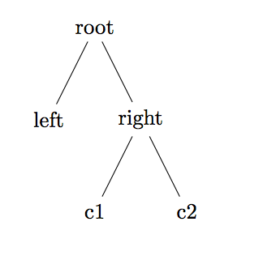
To add more children the node, you can simply nest the child command after the node.
\begin{tikzpicture}
\node {root}
child {node {left}}
child {node {right}
child{node{c1}}
child{node{c2}}
};
\end{tikzpicture}

Slide 8
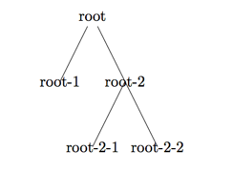
Naming child nodes
\node (root) {root}
child
child {
child
child
};
\node at (root-1) {root-1};
\node at (root-2) {root-2};
\node at (root-2-1) {root-2-1};
\node at (root-2-2) {root-2-2};
\end{tikzpicture}

Slide 9
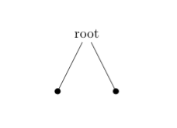
Using circles to represent node children
\begin{tikzpicture}
\node {root}
child {[fill] circle (2pt)} % 2pt specifies diameter
child {[fill] circle (2pt)};
\end{tikzpicture}

Slide 10
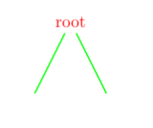
Adding color to the tree
\begin{tikzpicture}[thick]
\node [red] {root}
[green] % option applies to all children
child
child;
\end{tikzpicture}

Slide 11
Understanding Scoping
\scoped
[...] % Options apply to the whole tree
\node[...] {root} % Options apply to the root node only
[...] % Options apply to all children
child[...] % Options apply to this child and all its children
{
node[...] {} % Options apply to the child node only
...
}
child[...] % Options apply to this child and all its children
;
\end{tikzpicture}

Slide 12
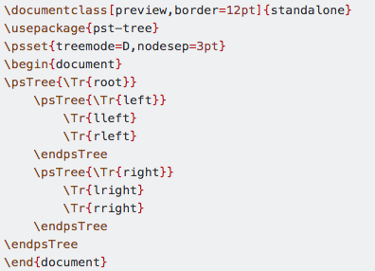
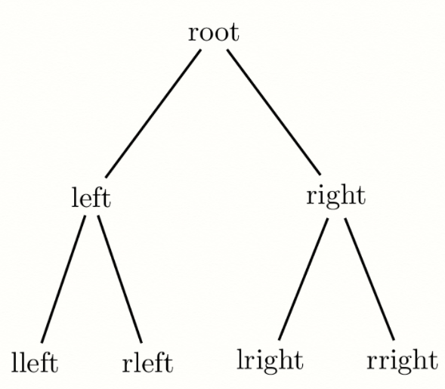
Useful Libraries for creating binary trees
\usepackage{pst-tree}

Slide 13
